Slide 1



Laser Beam Characterizer
Senior Design Fall 25 – Spring 26
Group 3
Zachary Andreasen PSE & EE | Thomas Cunningham EE | Lynzie Smith CpE
Sponsor: Lockheed Martin

Slide 2

Motivation and Background
Proper characterization of a laser is necessary in any laser application
Model matching important for sponsor’s applications
Need to know as many properties of laser as possible
  Wavelength
  Polarization
  Divergence
  Beam Quality
Seek a system that automates the process of data collection

Slide 3
Goals
Goals
Basic |  | Advanced | Stretch
Measure Polarization | Measure M2 Factor | Broad range of input powers | Broad range of wavelengths
Measure Wavelength | Measure Divergence | Broad range of input beam sizes | Measure beam waist size and location

Slide 4

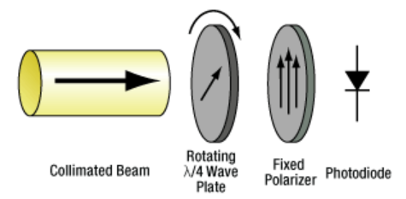
Objectives: Measuring Polarization
Use Rotating Quarter Waveplate Method [1]
  Quarter Waveplate
  Linear Polarizer
  Power Meter
Measures the Stokes Parameters
Will implement lens to focus large beams into power meter head
Will use stepper motor to control angle of waveplate

Slide 5
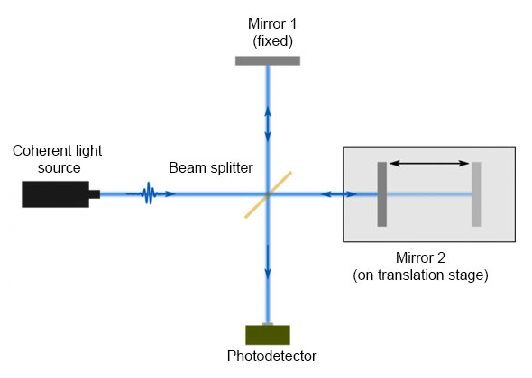
Objectives: Measure Wavelength
Use a Michelson Interferometer
  Non-Polarizing Beam Splitter
  Two Mirrors
  Motorized Stage for one mirror
  Photodetector
Will use a lens to transform linear fringes into Newton rings
Will use a stepper motor stage to translate one mirror

Slide 6

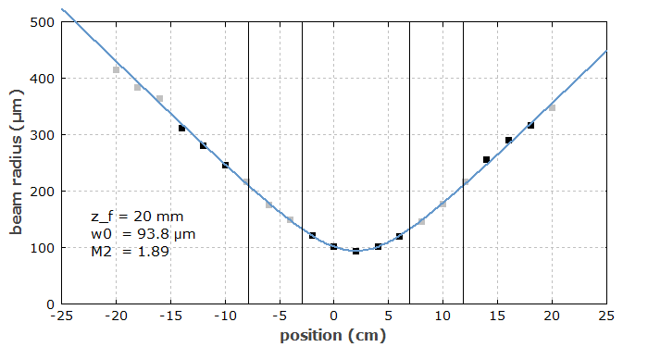
Objectives: Measure M2 Factor
Use a scanning knife edge to measure the intensity distribution of the beam
Use a lens to focus the beam to measure points both close and far from the beam waist
Use a 300 mm stepper motor stage to translate the beam profiler across the path of the focused beam
Intensity profile measurements performed at several points along the focused bath of the beam to obtain a beam width vs. propagation distance plot [2]

Slide 7
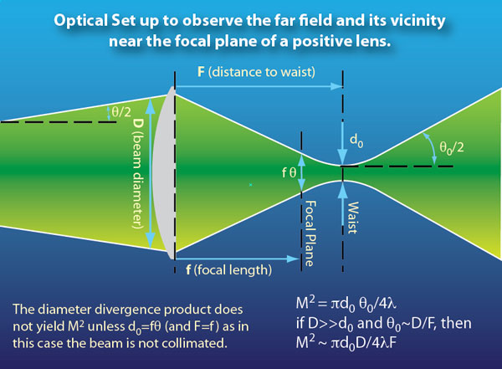

Objectives: Measure Divergence
Use the knife edge scan method used in measuring M2 factor to measure the beam size at focus
Use the beam width and focal length of lens to measure the divergence of the beam prior to the lens [3]

Slide 8
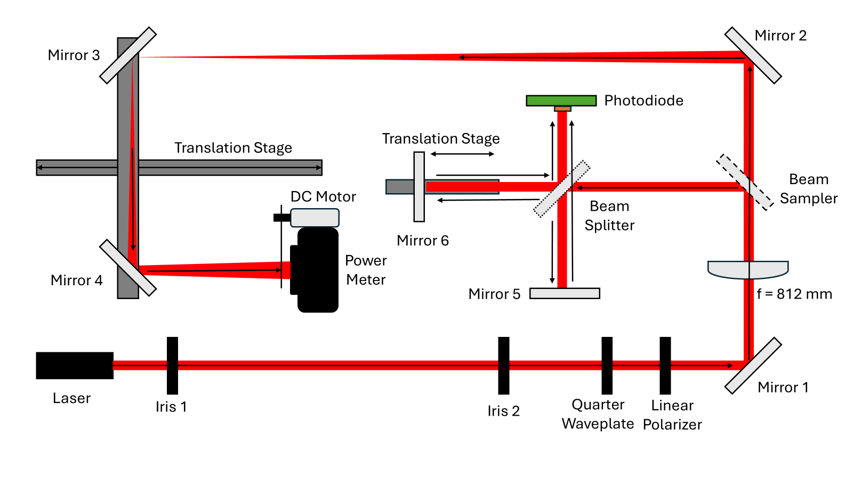
Optical Schematic Drawing

Slide 9
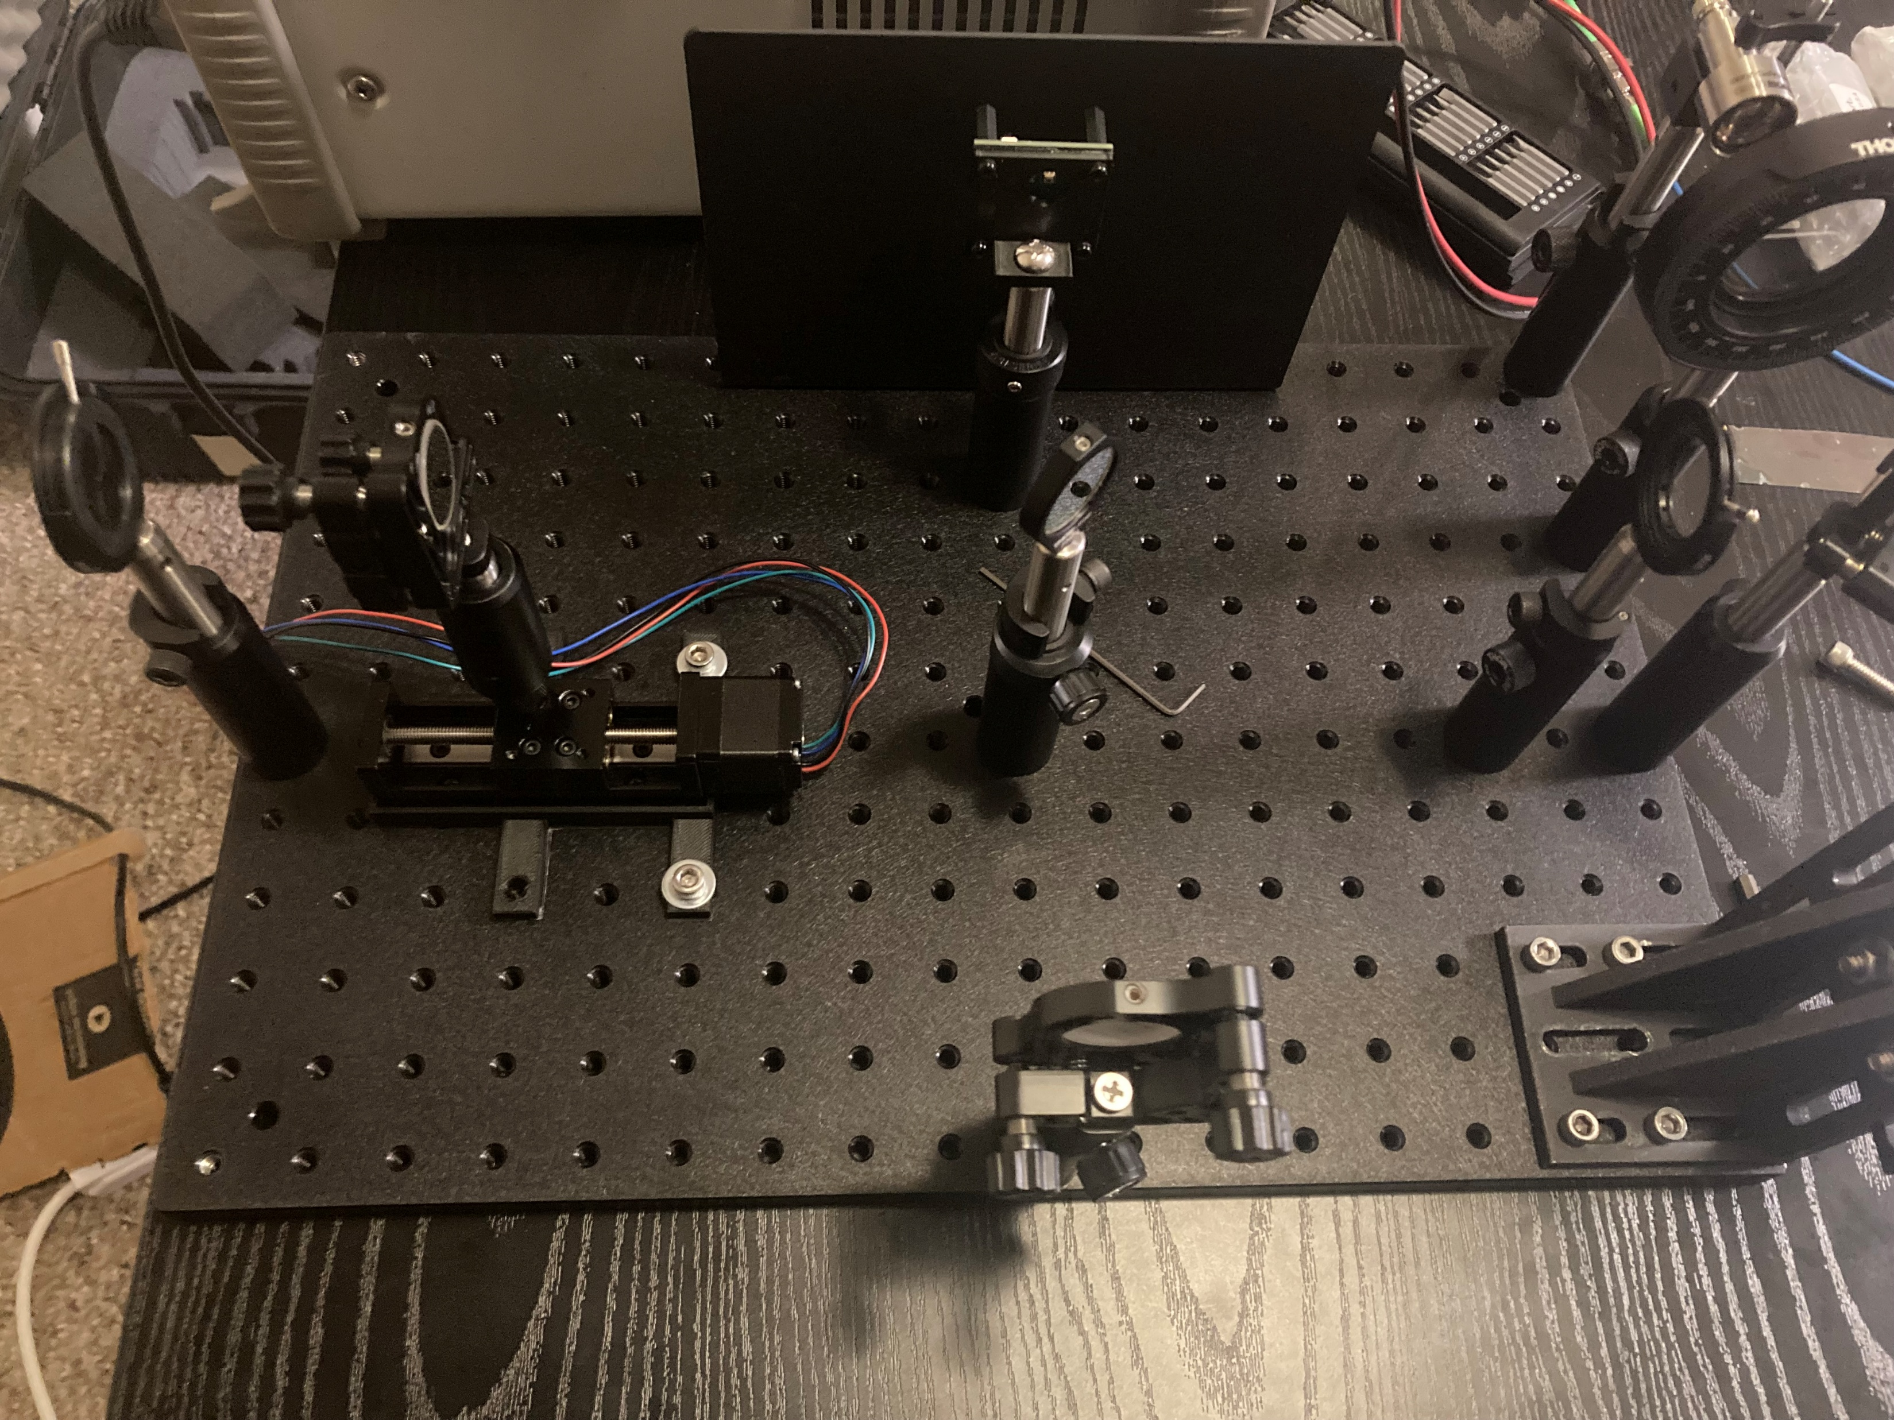
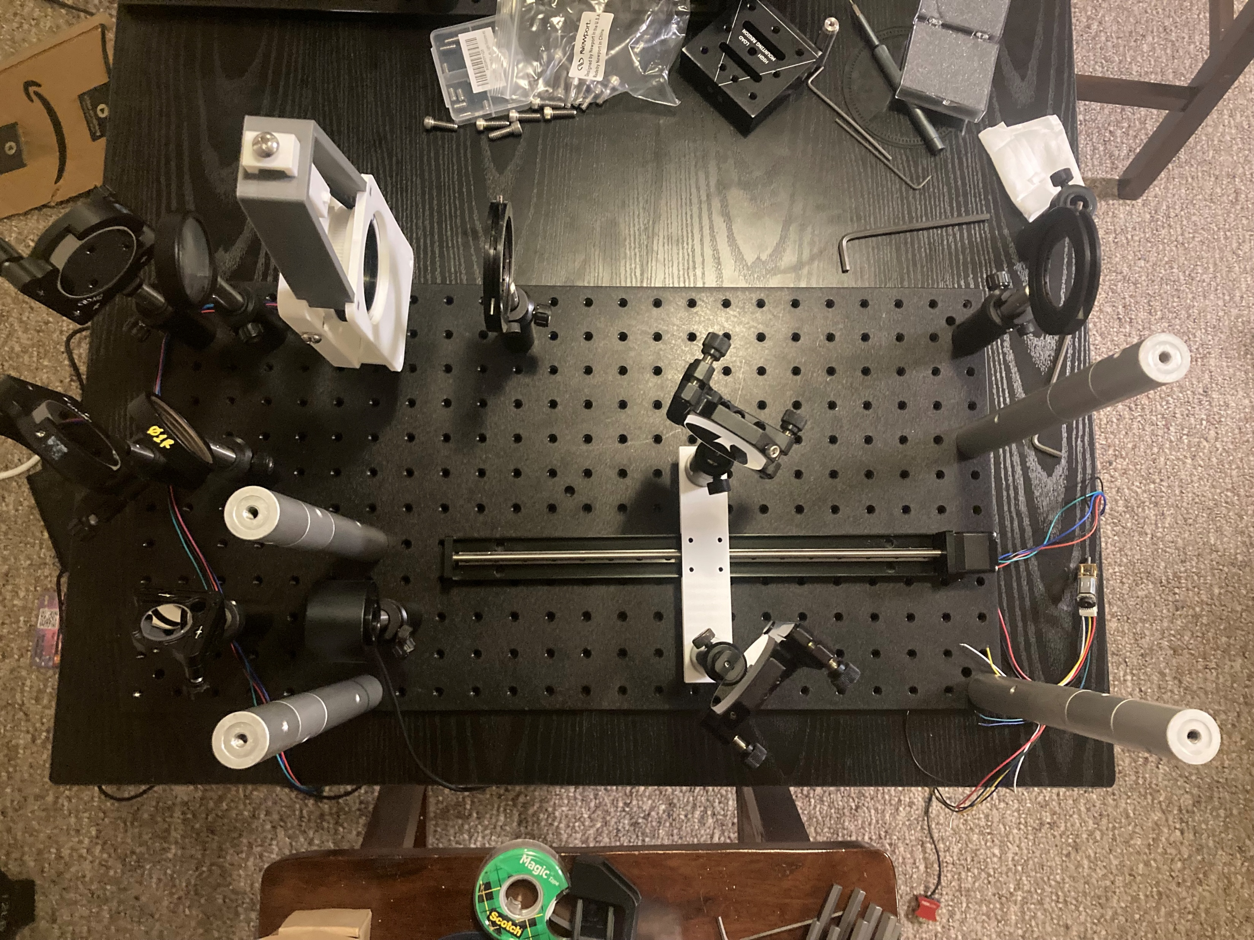
Full System Layout: 2 Layers
Top Layer
Bottom Layer

Slide 10
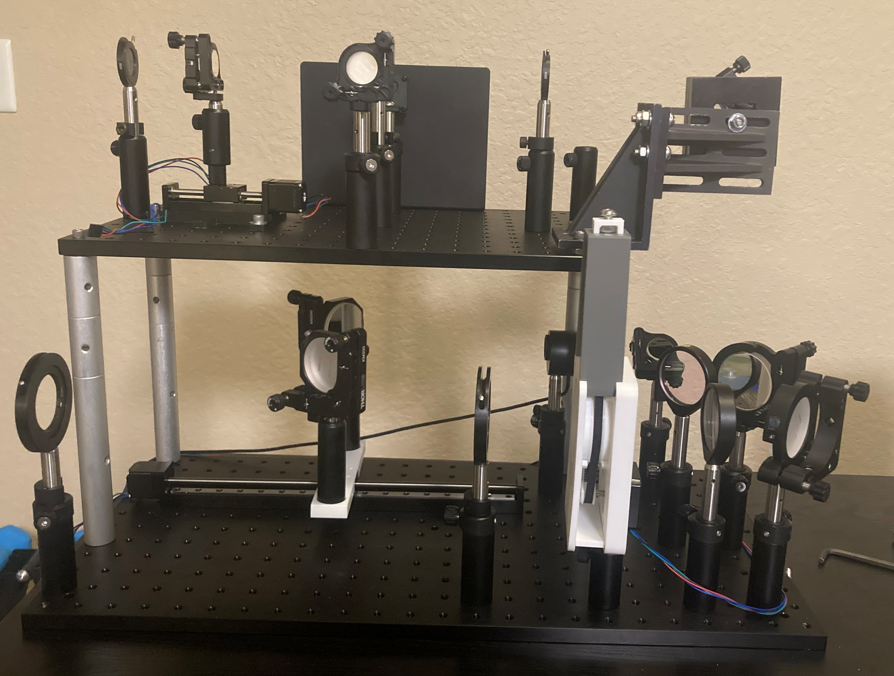
Full System
Two Irises are used for easy user alignment
Two layers stacked on top allows for conservation of space and reasonable portability
Long focal length lens (800mm)
Polarimeter is built as a custom mount with both the quarter waveplate and linear polarizer, integrated with a stepper motor to rotate the waveplate
Interferometer
Beam Profiling
Irises
Polarimeter
Focusing Lens

Slide 11
Engineering System Specifications
Input Beam Parameters
Parameter | Value | Units
Wavelength | 1.2 – 2.1 | µm
Maximum Power | 1 – 10 | W
Minimum Power | 1 – 50 | mW
Beam Diameter | 4 – 35 | mm
Measurement Parameters
Parameter | Value | Units
Normalized Stokes Parameters | ±0.05 for all Parameters | N/A
Wavelength | ±1 | nm
M² factor | ±0.1 | N/A
Beam Divergence | ±10 | µrad
Total Power | < 5 | % Error

Slide 12
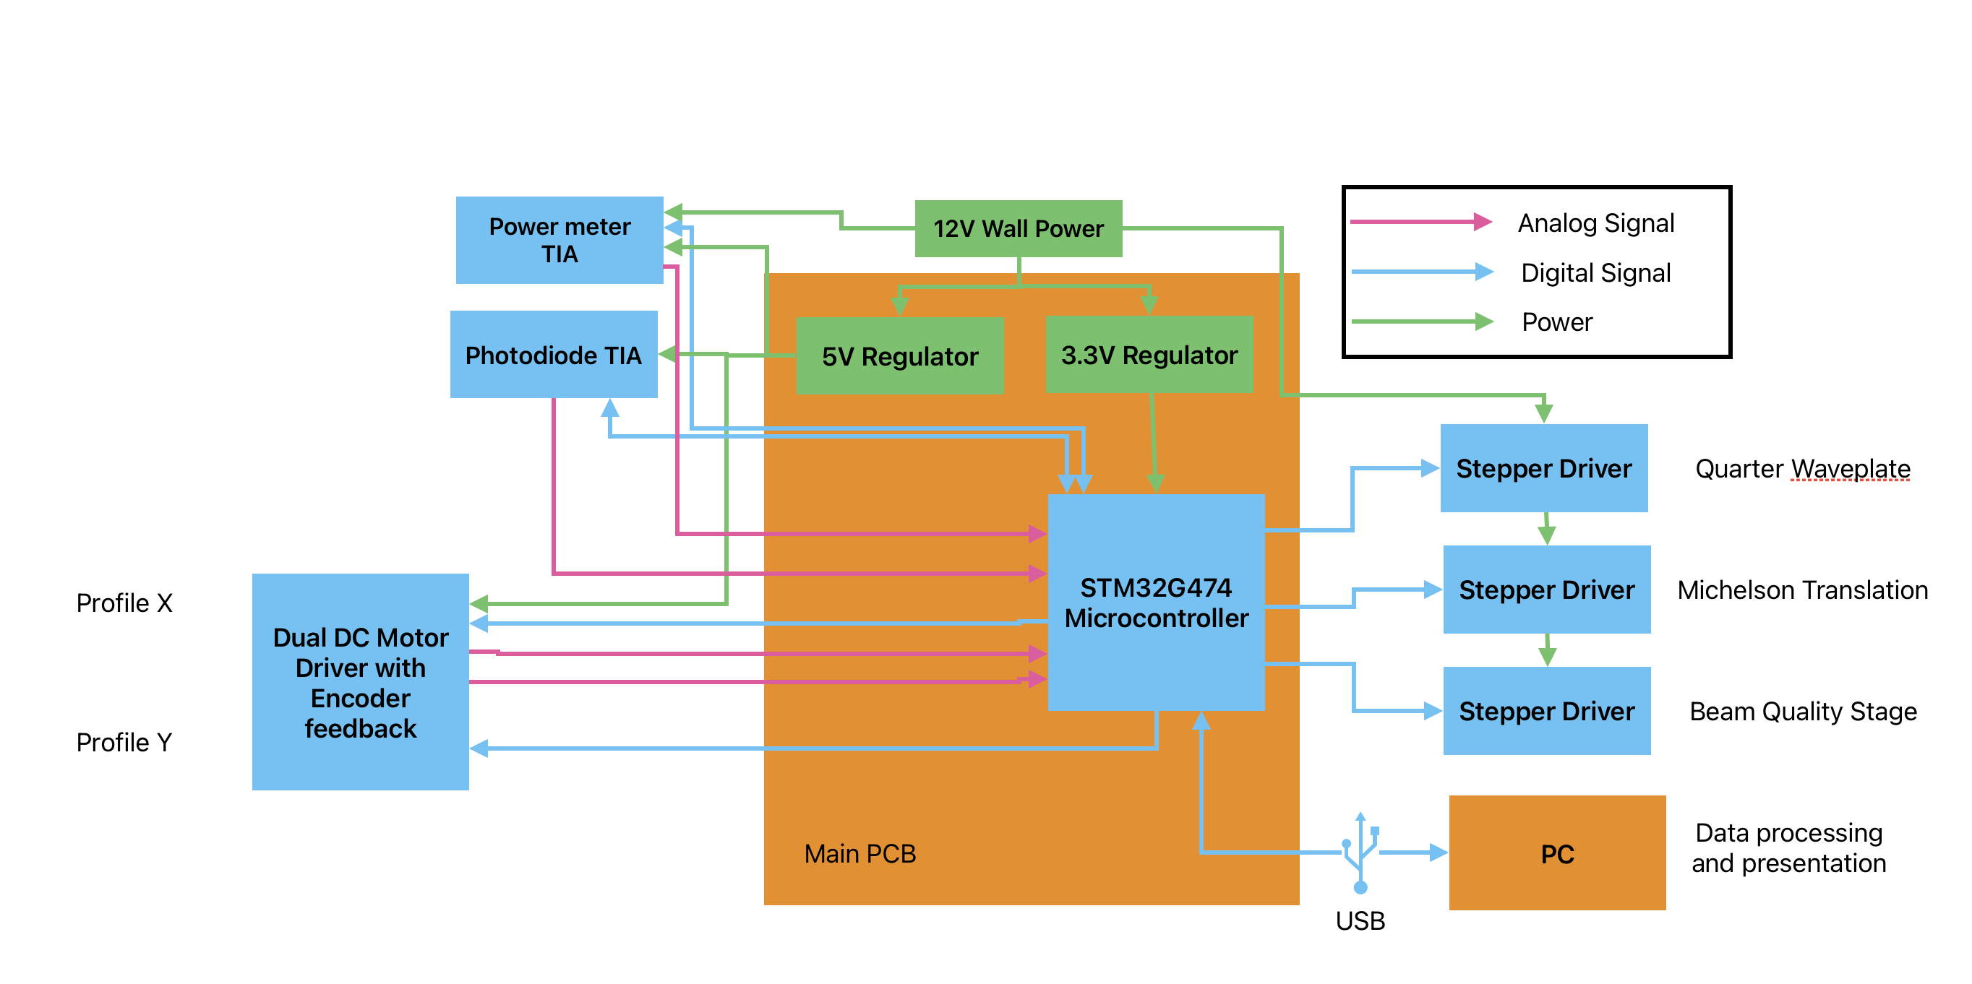
Hardware Diagram
Main PCB controls the motors and reads from the two photodiodes.
Live data is streamed through USB to a host PC.
The full system is powered through a 12V DC all power
adapter and
stepped down
to fit each
component's
needs.

Slide 13
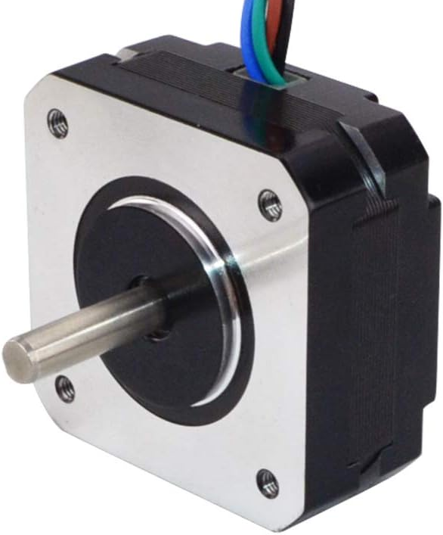
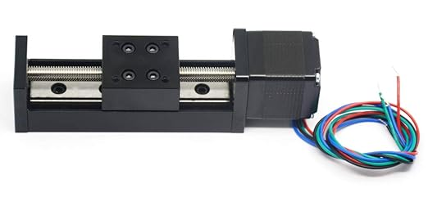
Motors: Steppers
Used 3 Stepper Motors in system
  Quarter Waveplate
  Beam Quality profile translation stage
  Michelson Interferometer mirror translation stage
Used Nema 17 Stepper for Quarter Waveplate rotation
Used Nema 13 Stepper Motor with integrated Stage for translation stages
All steppers run on a 12V supply and are controlled by the MCU
Nema 17 Stepper
Nema 13 Stepper with Stage

Slide 14
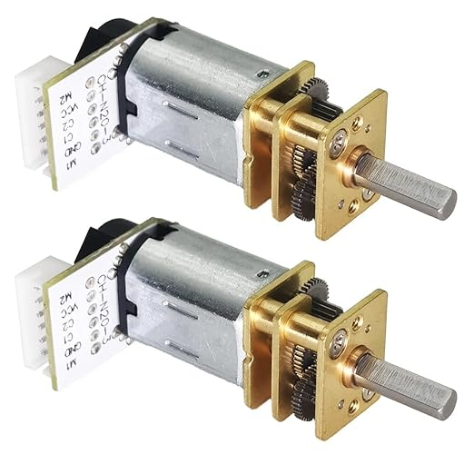
Motors: DC Motors
We are using two DC motors with encoder feedback and gear ratio reduction to execute beam profiling.
DC motors provide the constant speed required for the profiling calculations.
The speed can be monitored and controlled using a feedback loop inside the MCU to ensure the motors are spinning at a constant rate throughout the measurements.

Slide 15
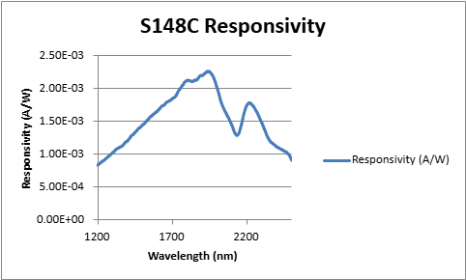
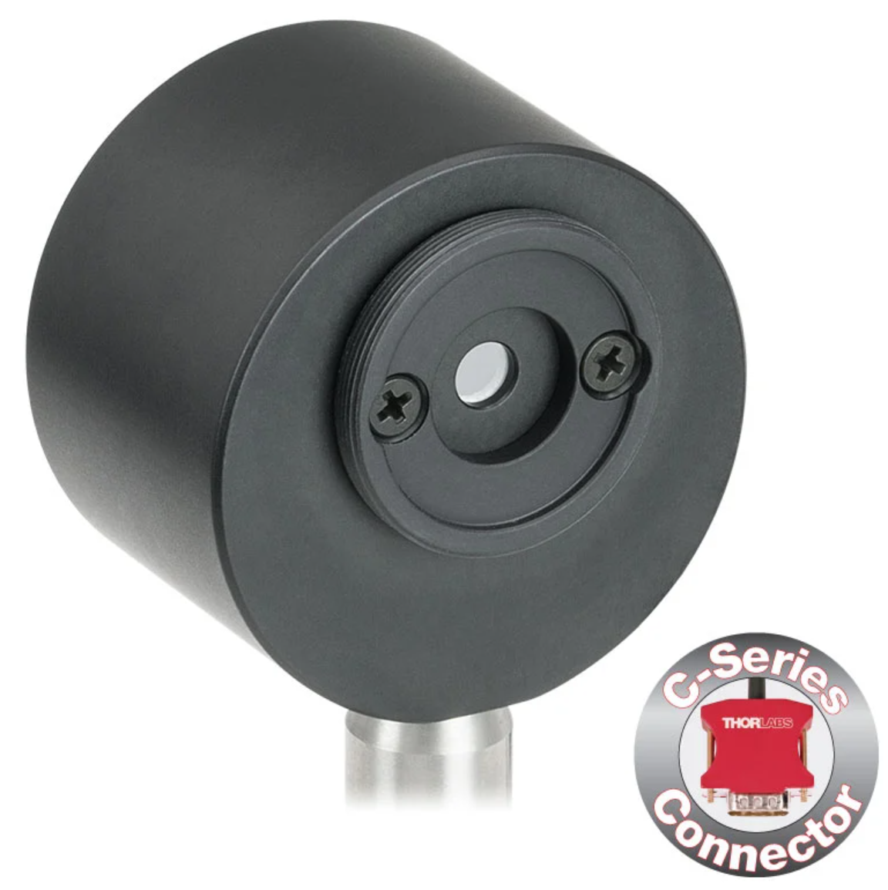
Hardware Selection: Power Meter Head
Part Selected: S148C
Pros
  5 mm diameter input aperture (much better than most photodiodes ~1mm²)
  Low Responsivity ~mA/W
Cons
  Dsub Connector requires custom different connector for TIA board

Slide 16
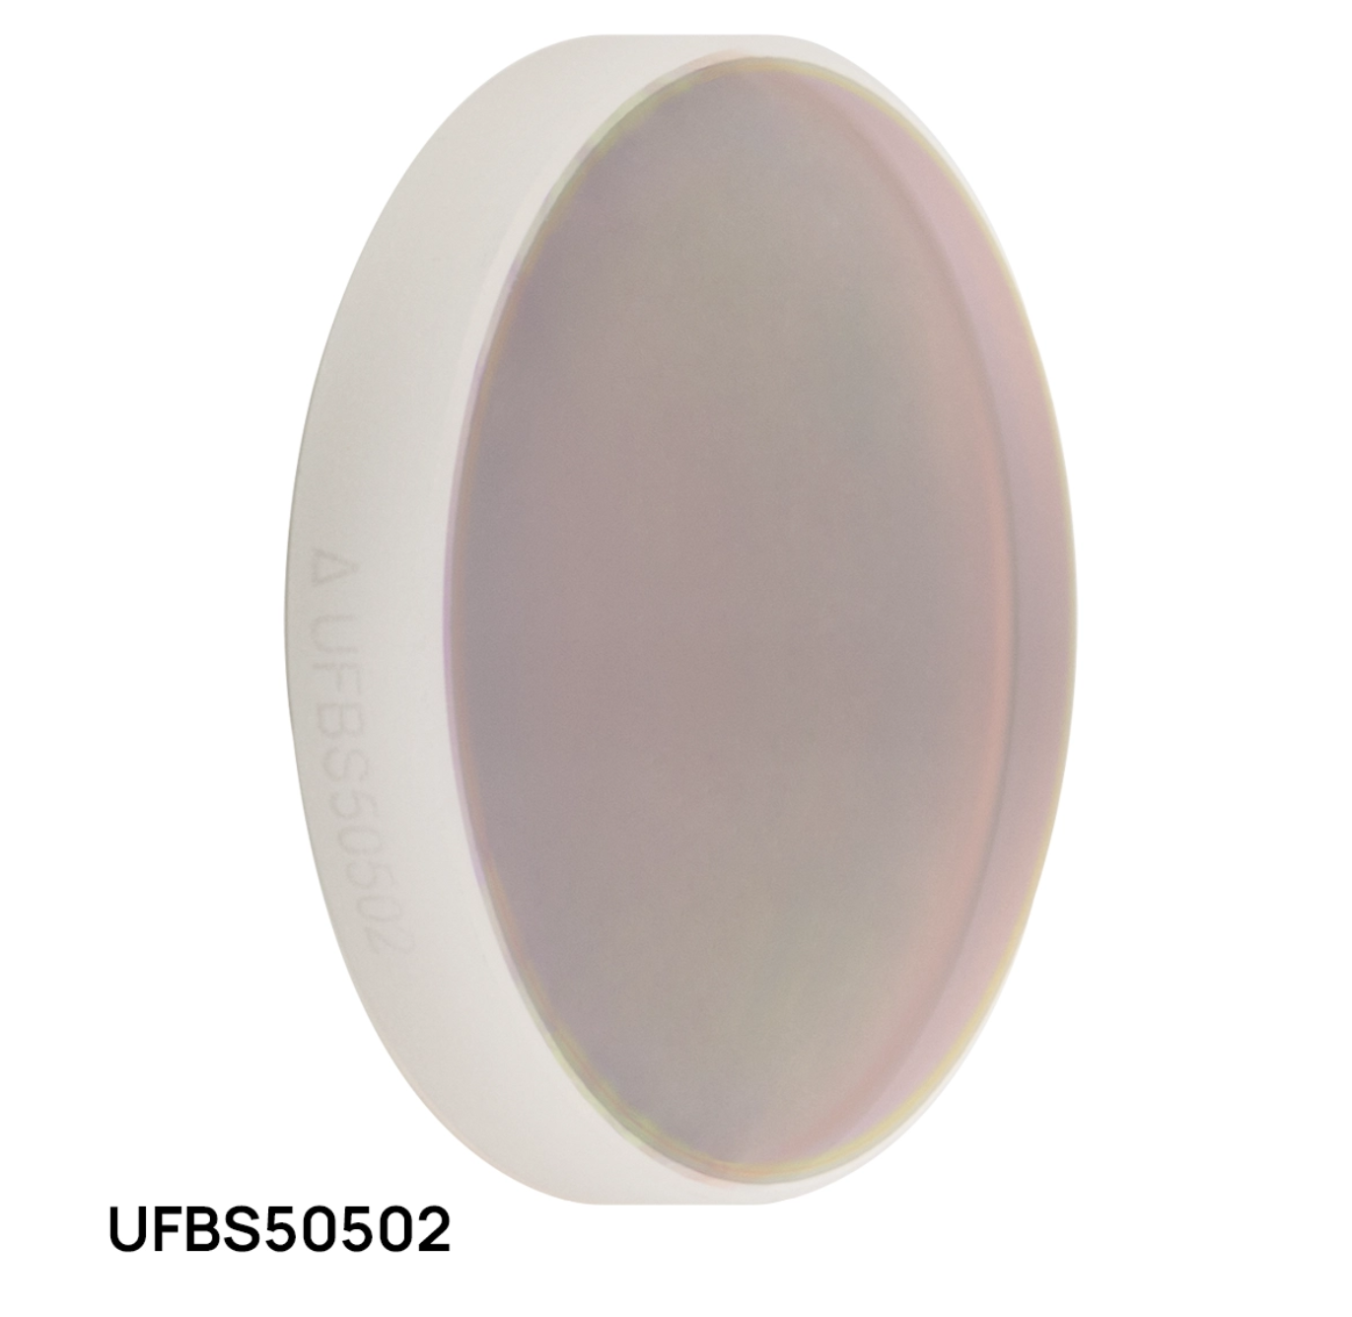
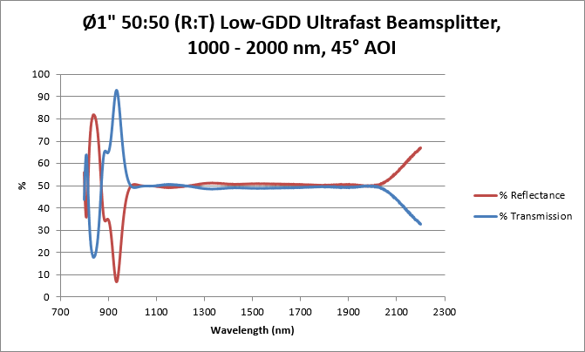
Hardware Selection: Beam Splitter
Part Selected: UFBS0502
Pros
  Spans desired wavelength range
  Very good 50/50 split across full wavelength range
Cons
  Plate beamsplitters can have undesired ghost rays from surface reflections
  Only optimized for P-Polarization
Reflectance vs Transmission Spectrum

Slide 17
MCU Selection
Feature | STM32 | ESP32
Reliable ADC | Known for linearity 16-24 ADC channels across 2-3 ADCs Flexible DMA | Struggles with noise 18 ADC channels across 2 ADCs DMA via digital control
Robust Motor Driving | Many GPIO with advanced timers Native software support | Less advanced timers Community libraries available for motor driving
USB Support | Native and robust | Included + drivers required
Additional Perks | Industry standard microcontroller family | Many native wireless communications
STM32 was chosen over ESP32 mainly for its better ADC which is more accurate and linear.
Another advantage of STM32 is its native motor driving software which is important since we have multiple motors for this project.
The more standard microcontroller in the industry and overall more robust than the ESP32.

Slide 18
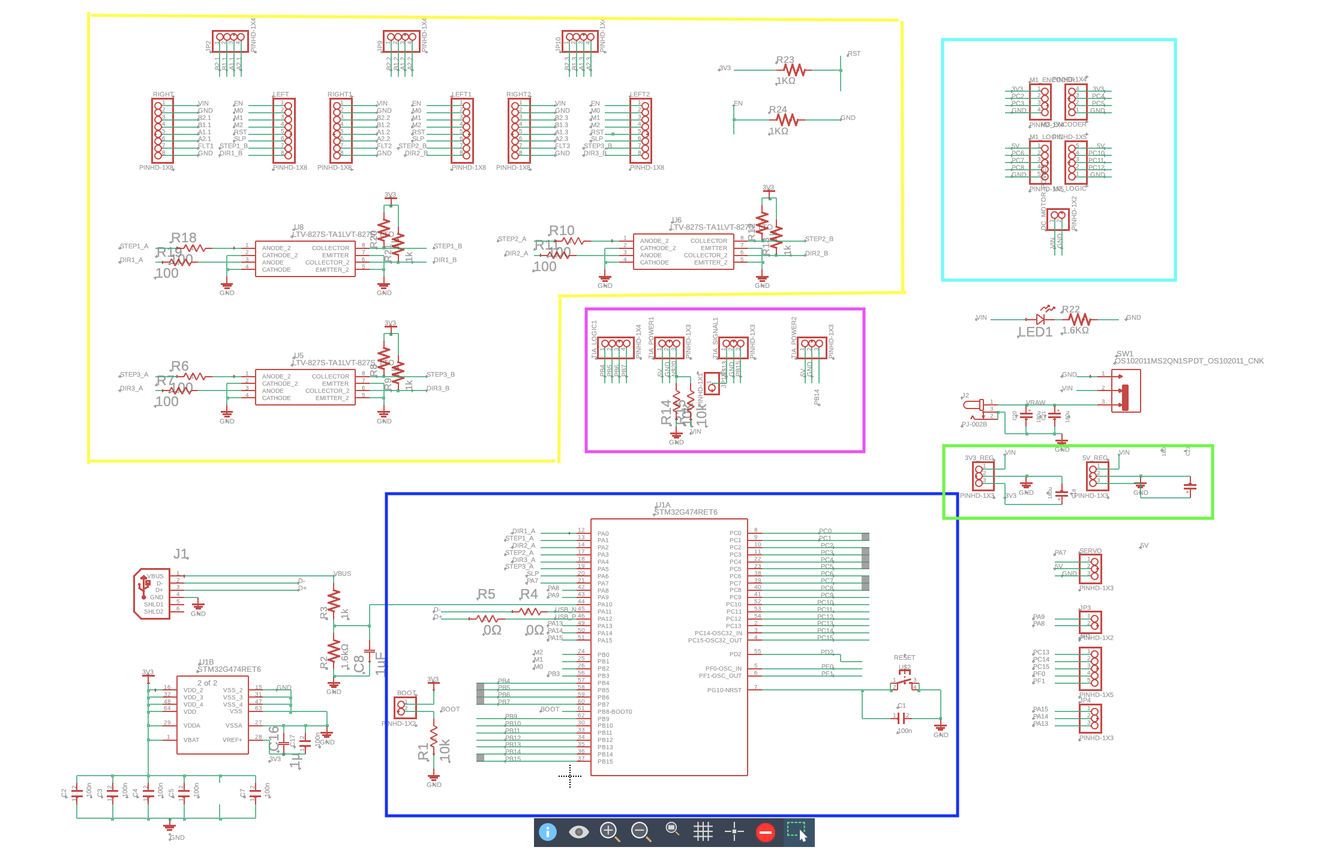
MCU Design
The main PCB is
designed to
interface with
the motors, sensors,
and connect to a
PC.
They schematic
follows the
recommendations
from the STM32
datasheet

Slide 19
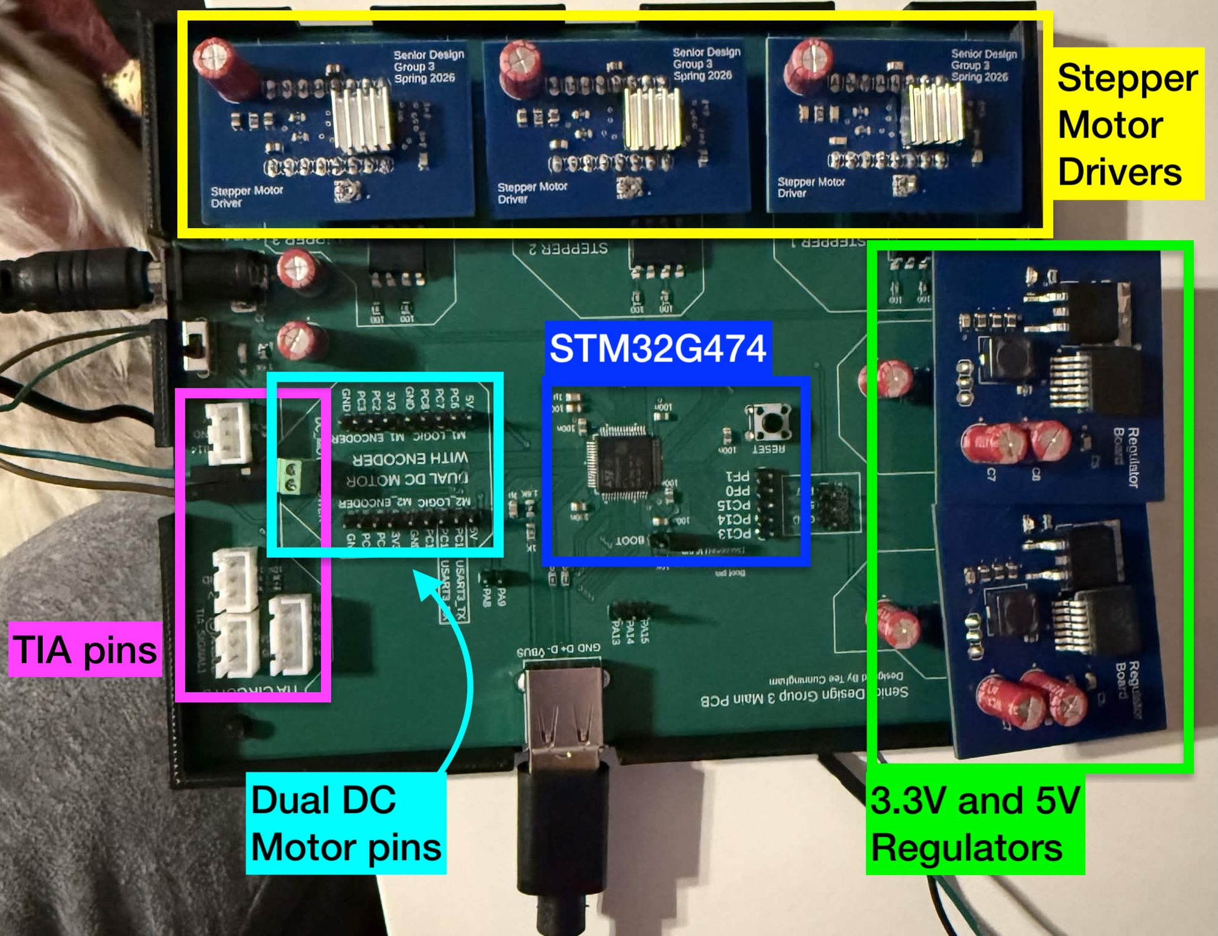
MCU Design
The Main board layout is designed to be modular and accessible.
The three motor drivers and two voltage regulators connect directly onto the board via header pins.
JST connectors are used for the TIA pins to ensure a firm connection

Slide 20
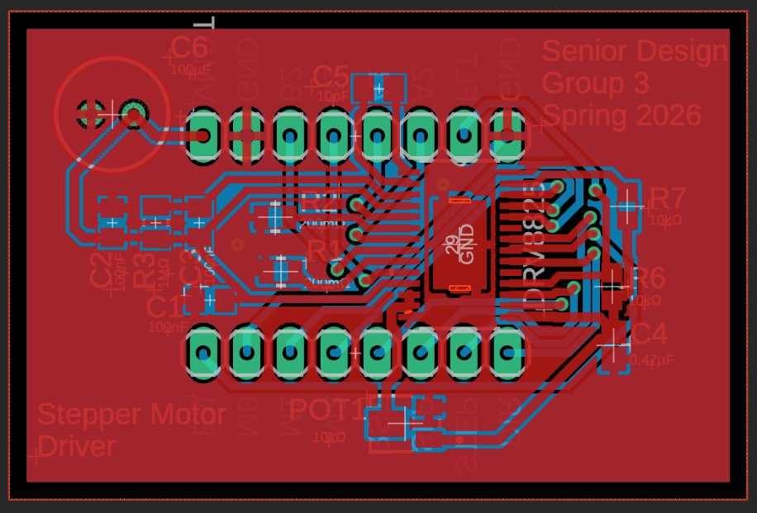
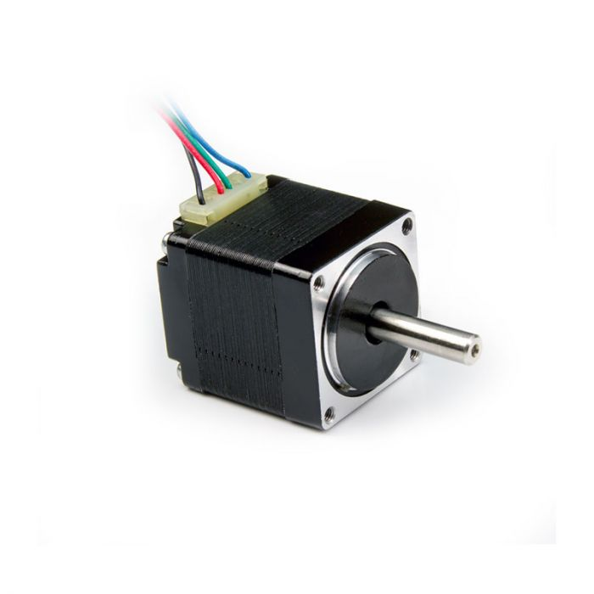
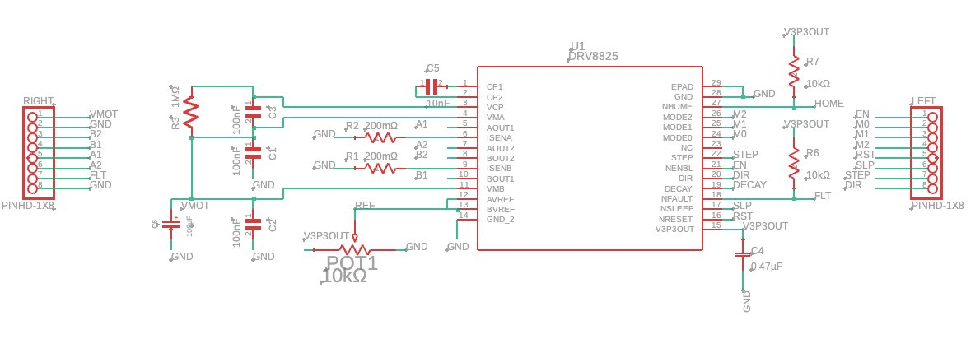
Motor Driver Design
The stepper motor drivers utilizes the TI made DRV8825 chip.
The board is designed to fit onto the main PCB via header pins.
The circuit is laid out as recommended by the DRV8825 datasheet.
NEMA 13 stepper motor

Slide 21
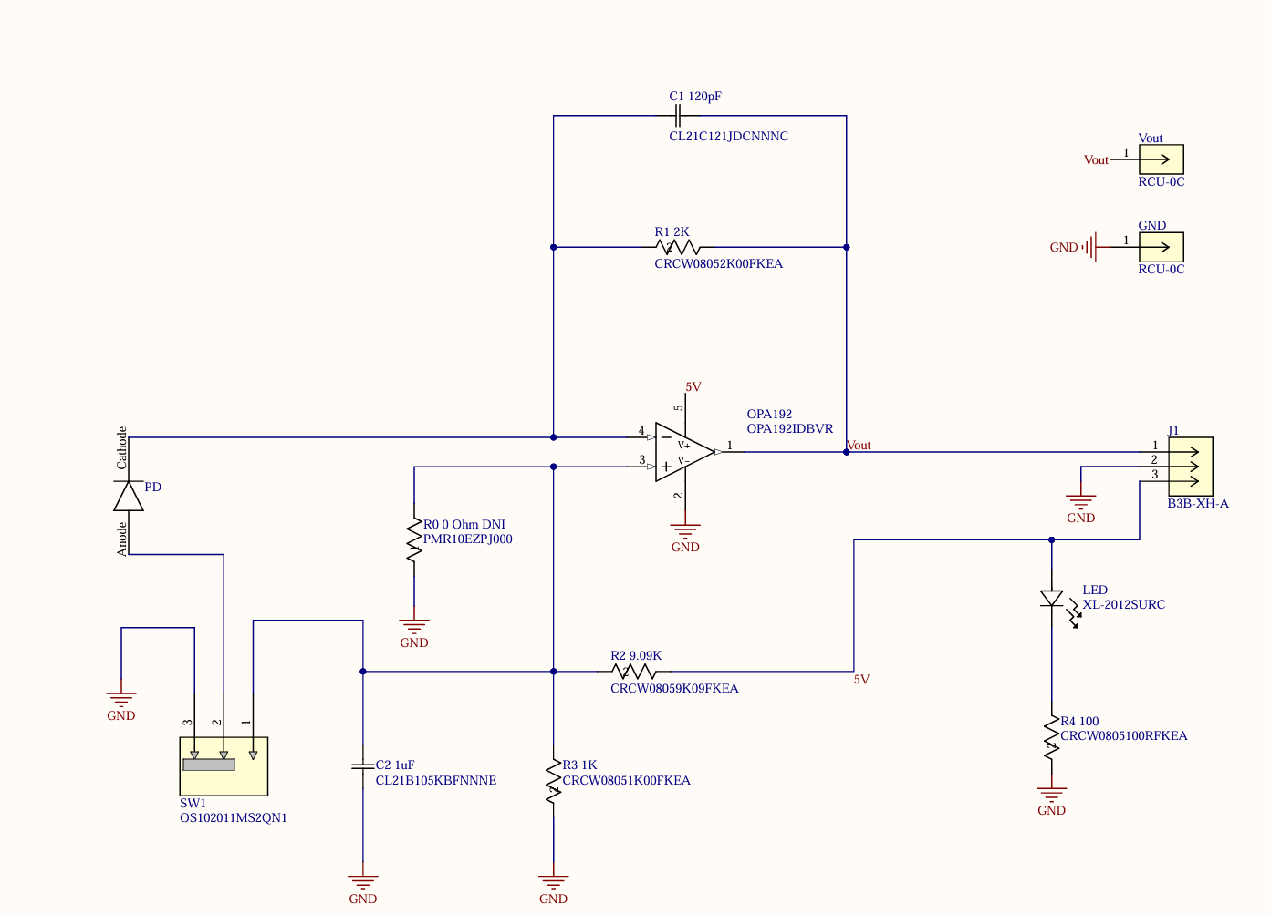
Photodiode TIA Design
Simple Extended InGaAs Photodiode (800 – 2600nm Spectral Range)
OPA129 Op Amp used for its low noise features

Slide 22
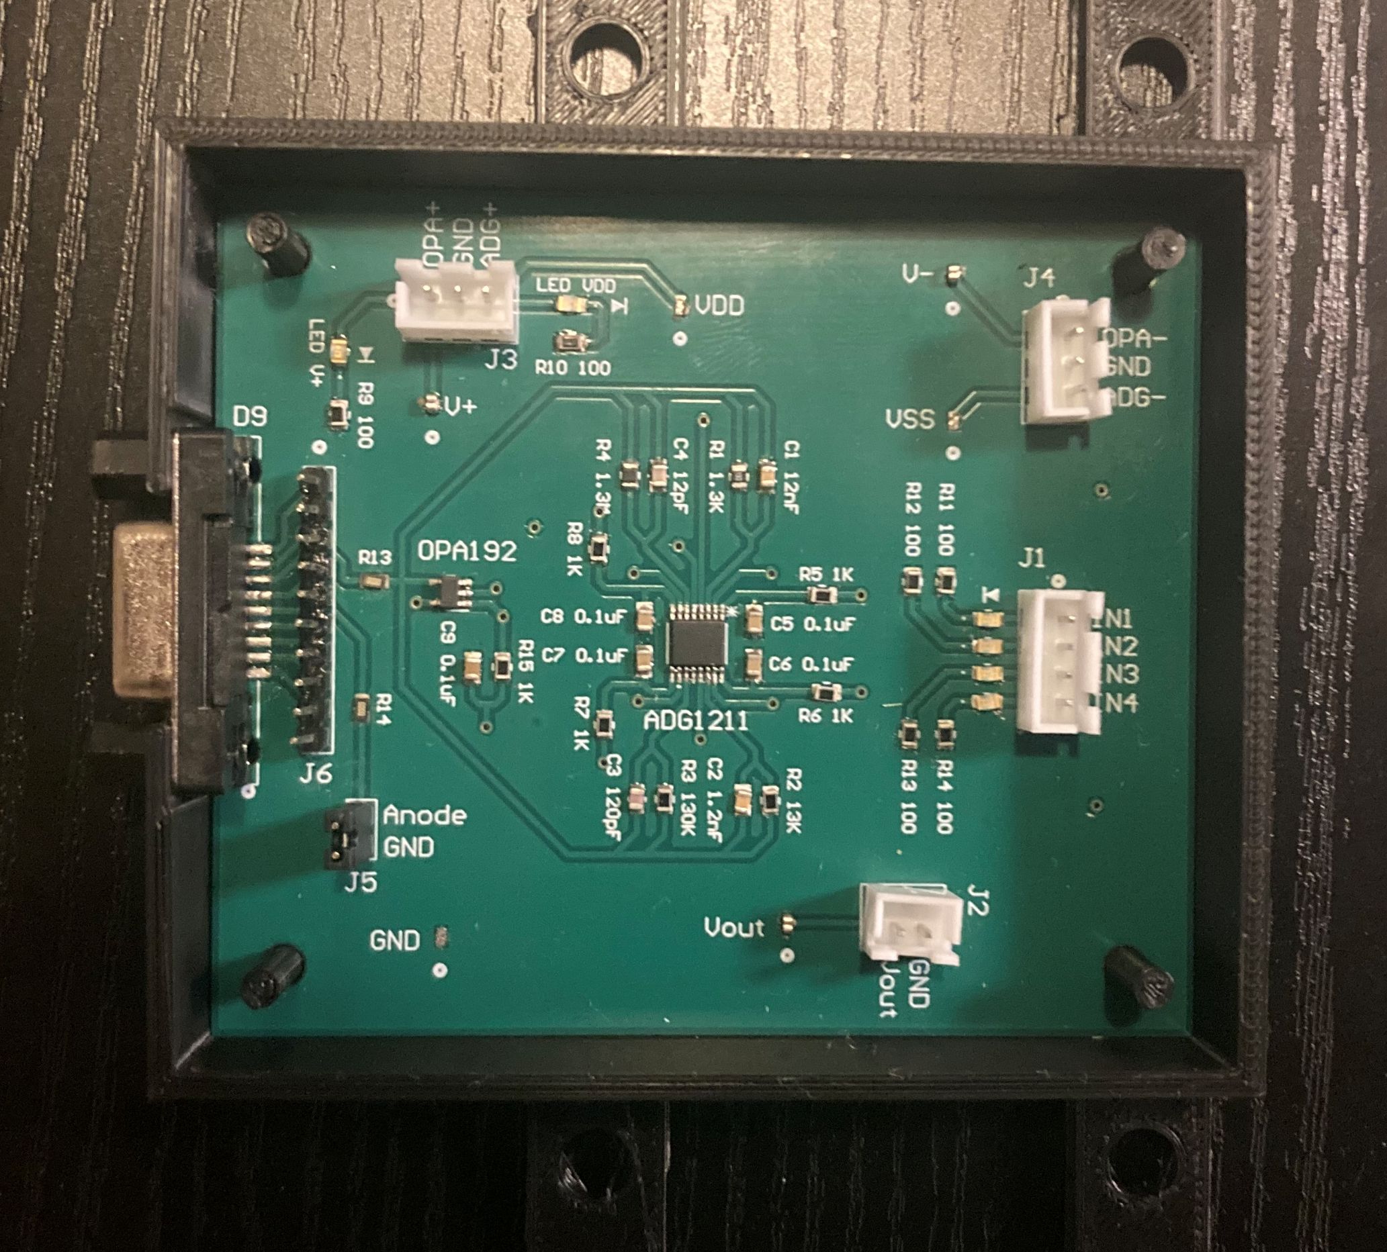
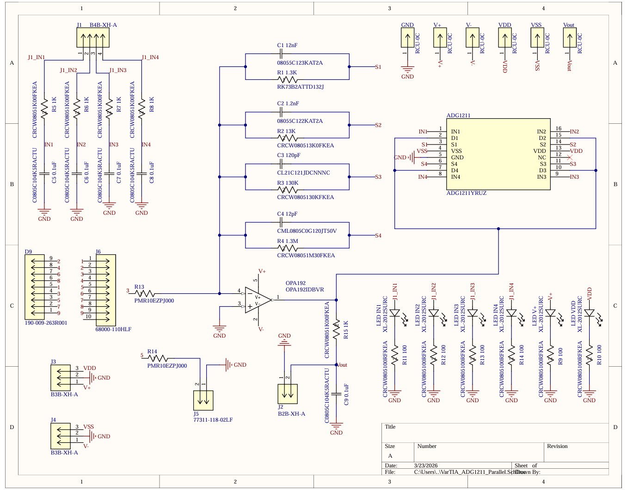
Variable Gain TIA Design
Uses ADG1211 voltage-controlled switches to enable the MCU to control the feedback resistance of the TIA
Four feedback resistors wired in parallel each connected to a switch of the ADG1211
  R1 = 1.3 kΩ
  R2 = 13 kΩ
  R3 = 130 kΩ
  R4 = 1.3 MΩ

Slide 23
Software Selection
P
Our choice of Embedded C as the programming language allows for precise ADC timing, DMA, motor control and deterministic behavior.
The main reason of using Python as our main PC GUI programming language is because it allows for a scalable GUI for system control and data analysis.
Additionally able to create nice looking plots for data visualization.
Layer | Option | Performance/Real Time | Hardware Access
Embedded Firmware | Embedded C | Highest | Full
Embedded Firmware | MicroPython | Low | Limited
PC GUI / Analysis | PySide6(Qt) | High | Indirect (USB)
PC GUI / Analysis | Tkinter | Low-Moderate | Indirect

Slide 24
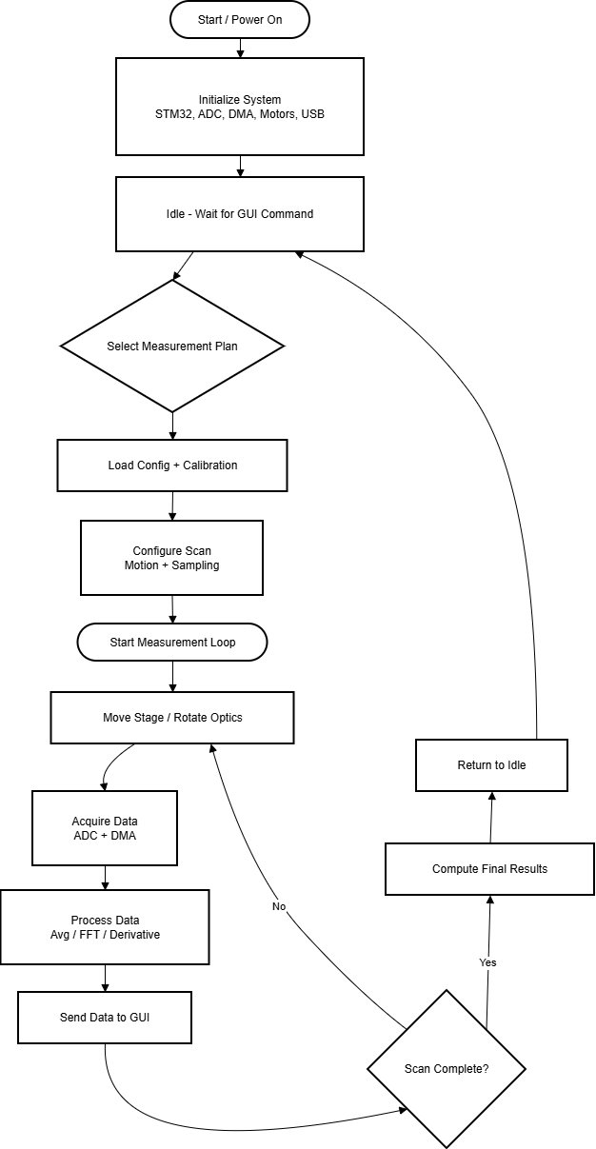
Embedded Firmware:
Software Flowchart
System initializes STM32 peripherals(ADC, DMA, timers, motors, USB)
Firmware waits for measurement plan selection from GUI
Selected plan configures scan parameters and calibration
Closed-loop measurement process:
  Motion control (stages/optics)
  Sensor data acquisition (ADC + DMA)
  Real-time signal processing
Processed data is streamed to GUI for visualization
Final beam parameters computed and system returns to idle

Slide 25
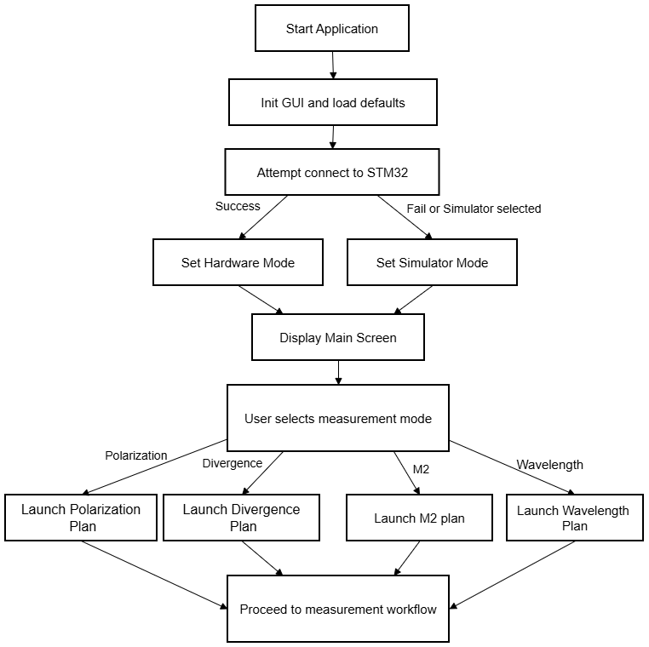
GUI: Software Flowchart
Once the application is started it initializes the GUI and loads up the defaults.
It should automatically search for a serial communication port to attempt connection to.
If success, main screen is shown and you are able to select the measurement system (or automatically run all measurements systems in order).
Once measurement system is selected GUI sends commands to start the measurement workflow scripts on STM32.
And in turn data collection is sent back to GUI for data processing

Slide 26
Problems and Troubleshooting
General
  Hardware Acquisition Delays
  Alignment
Electrical
  TIA Nonlinearity
  MCU Stepper driver
Software
  Beam Profile Timing
  Noise Filtering (especially for beam profiling)

Slide 27
Work Distribution
Photonics Engineering | Responsibilities
Zachary Andreasen | Project Lead Optical Alignment Polarimeter, Michelson, M² System Design Photodiode Selection
Electrical Engineering | Responsibilities
Tee Cunningham | MCU Selection + Design Motor/Motor Driver Selection + Design Power Supply Design
Zachary Andreasen | Michelson TIA Design Power Meter Variable TIA Design
Computer Engineering | Responsibilities
Lynzie Smith | GUI Software architecture + Implementation Serial Communication Integration STM32 Firmware Website Design

Slide 28
References
B. Schaefer, E. Collett, R. Smyth, D. Barrett, and B. Fraher, “Measuring the Stokes polarization parameters,” Am. J. Phys., vol. 75, no. 2, pp. 163–168, Feb. 2007, doi: 10.1119/1.2386162.
R. Paschotta, “M² factor – M squared, laser beam, quality factor, beam divergence, caustic, ISO Standard 11146.” Accessed: Sep. 05, 2025. [Online]. Available: https://www.rp-photonics.com/m2_factor.html
Edmund Optics, “Gaussian Beam Propagation | Edmund Optics Knowledge Center.” [Online]. Available: https://www.edmundoptics.com/knowledge-center/application-notes/lasers/gaussian-beam-propagation/

